Slide 1
Embry-Riddle Aeronautical University ASCEND! Project Overview
By: Geimi DeLarge
NASA Space Grant – ASCEND!
Mentors: Dr. Ronald Madler, Jack Crabtree
April 17, 2010

Slide 2
Overview
The Team
Flight Objectives
Payload Components
Data Acquisition
The Launches
Conclusion

Slide 3
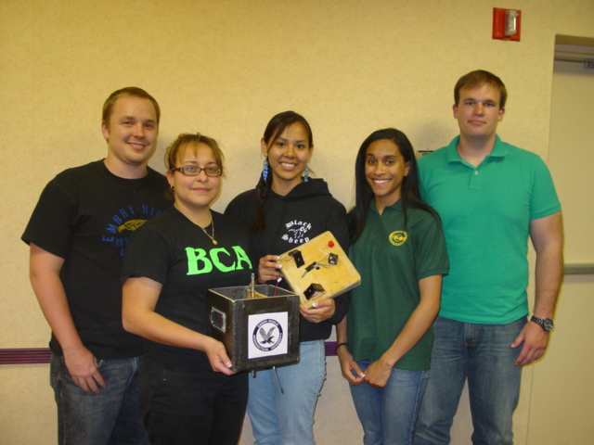
The Team
Noah Stokely, Jessica Avitia, Mary Begay, Geimi DeLarge, and Nicholas Hammons
4/17/2010

Slide 4
Flight Objectives
Gather atmospheric data
Experiment with composite structures and construction methods
Gather pressure data
Gather Geiger counter data
Gather sunsensor data
4/17/2010

Slide 5
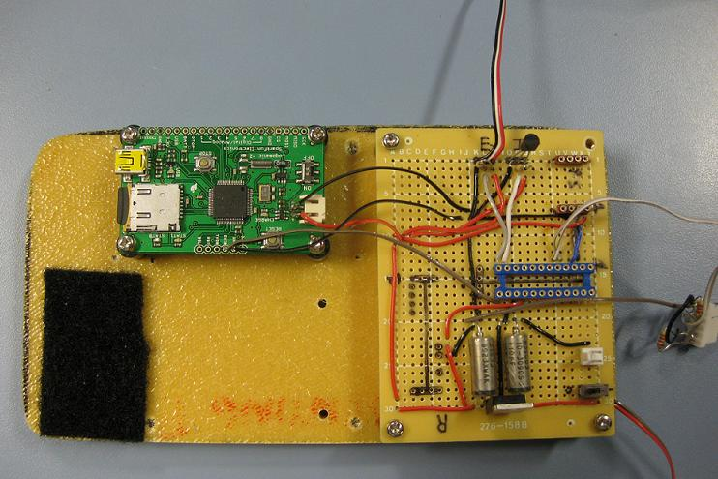
Payload Components
SD Datalogger
Internal Temperature
Pressure Sensor

Slide 6
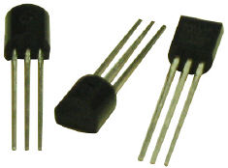
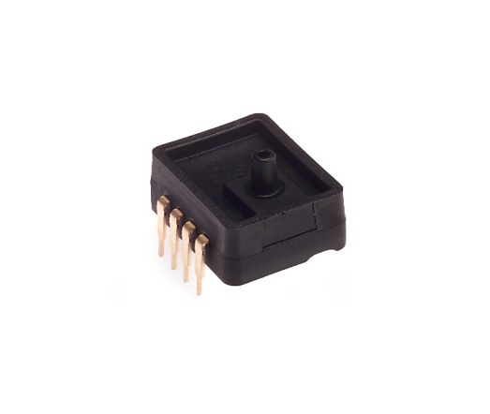
Payload Components
Dallas DS18B20 – One Wire Device
Digital Sensor
Internal/External
9 – 12 bit Measurements
Degrees Celsius
Range of -55°C to +125°C
Accurate to ±0.5°C
Source: www.embeddeddatasystems.com
Honywell Analog Pressure Sensor – ASDX Series
Analog Sensor
Approx. Frequency : 1Hz
Range: 0 – 15 psi
Absolute Pressure
Source: http://rocky.digikey.com

Slide 7
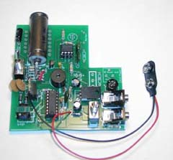
Payload Components
Digital Geiger Counter
Alpha, Beta, and Gamma rays
Compare to altitude
Source: imagesco.com

Slide 8
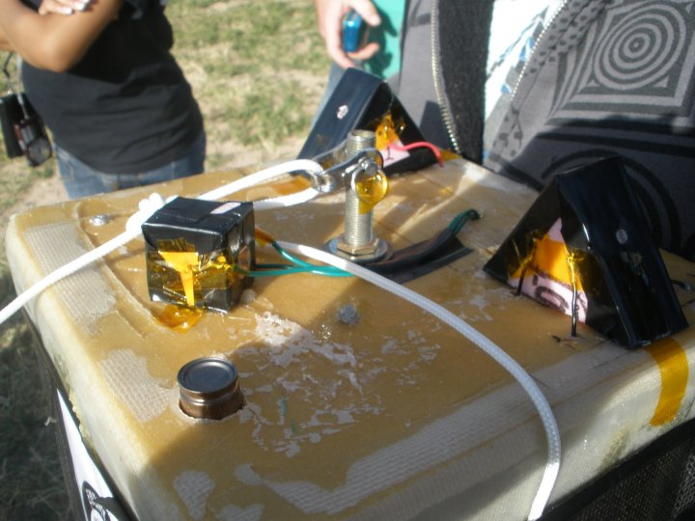
Payload Components
Sun Sensor:
Fall 2009
3 solar cells mounted on exterior of payload
Record Voltage
Compare with altitude
Check for viability for future sun sensor
Spring 2010
Photoresistors took the place of the solar cells
Spring 2010: Payload Lid

Slide 9
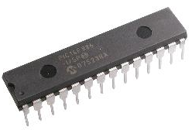
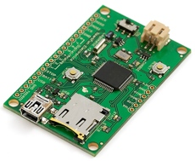
Data Acquisition System
UK-based microcontroller system
Basic Programming Language
28-X1 Chip
Faster Serial Output Capabilities
Larger Memory
Converts Analog Signal
8 bit
10 bit
Source: www.hvwtech.com
Logomatic Data Logger
Utilizes SD Card – Up to 2GB
FAT16 Format
Serial Input From Picaxe
Source: www.inmotion.pt

Slide 10
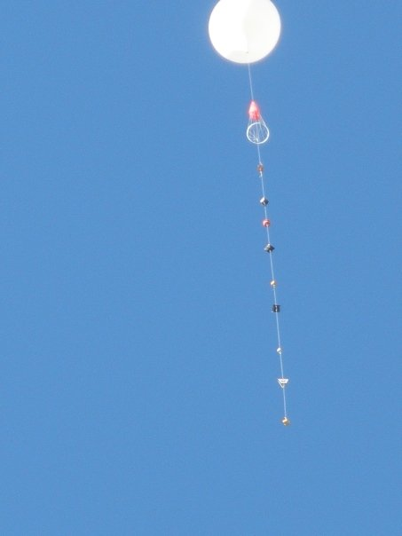
Fall 2009 Launch
Max altitude: 84,803 feet
Distance traveled: 72.53 miles
Components Flown:
Temperature
Pressure
Geiger Counter
Solar Cells
GPS

Slide 11
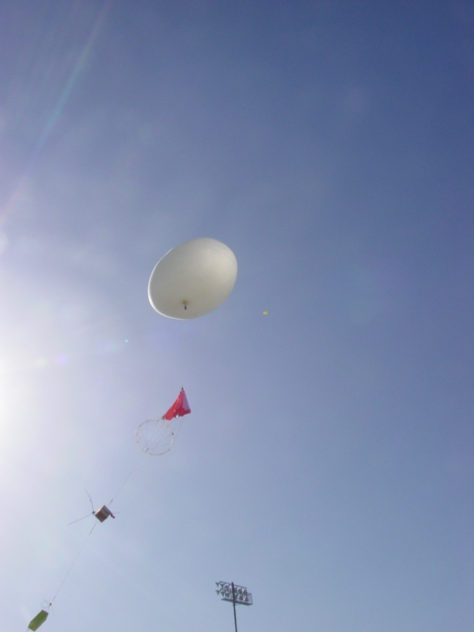
Spring 2010 Launch
Max altitude: 84,803 feet
Flight distance:89.85 miles
Components Flown:
Temperature
Pressure
Geiger Counter
Photoresistor

Slide 12
Conclusion
Two successful flights for the 2009-2010 academic year
Hopefully use data to aid in the development of a sun sensor
Continue ASCENDing!

Slide 13
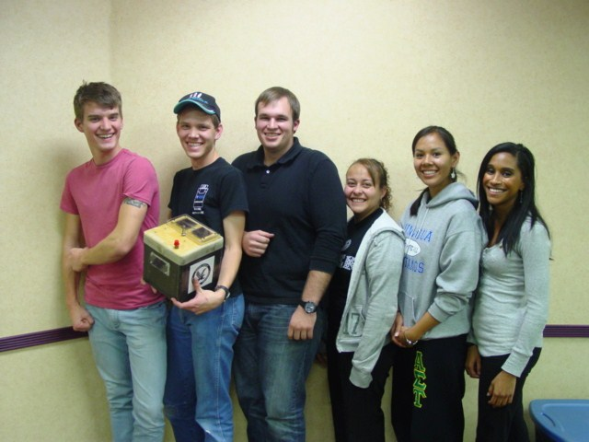
QUESTIONS??

